Slide 1

Seeds and Sustainability: Countering Deforestation in Pakistan
Deforestation is Pakistan's most pressing environmental challenge. Green cover is now less than 5% of the total land area, contributing to soil erosion, floods, and loss of biodiversity.
The "Seeds and Sustainability" project proposes a holistic approach combining reforestation, modern agricultural tech, and community engagement to build a greener future.

Slide 2
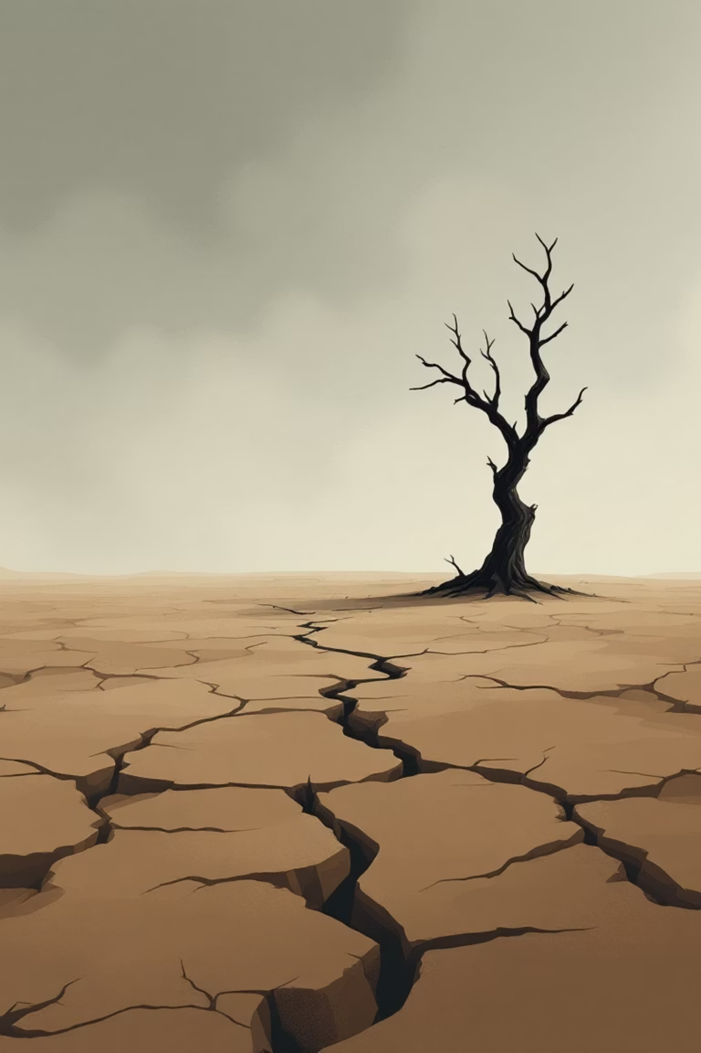
The Crisis: Causes and Consequences
Key Causes
Uncontrolled urban expansion and agricultural conversion.
Illegal logging and unregulated timber trade.
High fuelwood dependency in rural areas.
Weak environmental policy enforcement.
Severe Consequences
Loss of native biodiversity and forest ecosystems.
Decline in soil fertility and agricultural output.
Groundwater depletion and worsening flash floods.
Pakistan ranks among the top 10 most climate-vulnerable nations.

Slide 3



Rethinking Growth: The Seeds and Sustainability Philosophy
Every seed planted is an act of climate resistance.
This initiative aims to restore green ecosystems and build an environmentally aware generation through natural and technological innovations.
Community Seed Banks
Aerial Seeding
Native Species Focus
Store and distribute native seeds for local reforestation efforts.
Use drones for rapid reforestation in hard-to-reach, deforested regions.
Reintroduce resilient native trees like Neem, Sheesham, and Kikar.

Slide 4

Chapter Break: Innovation in Agriculture
New Ways to Grow
With agricultural land disappearing, Pakistan must leverage technology to sustain food production and greenery.

Slide 5

The Role of Technology: Hydroponics & Aeroponics
Hydroponics: Soil-Free Cultivation
Uses nutrient-rich water instead of soil.
Saves up to 90% of water compared to traditional farming.
Enables rooftop and vertical farming in dense urban centers.
Aeroponics: Air & Mist Growing
Grows plants in air or mist environments.
Consumes minimal space and water.
Ideal for urban centers and can be solar-powered for sustainability.
These methods allow food production and greenery even where soil and land are unavailable.

Slide 6



Community Empowerment and Education
Technology requires people's involvement. This initiative empowers citizens to take charge through education and engagement.
Rural Engagement
Youth & Education
Cultural Motivation
Train farmers in tree nursery management and employ locals in seed collection and monitoring.
Integrate environmental awareness in schools and organize national student planting campaigns.
Frame sustainability within Islamic principles like Khilafah (stewardship) to inspire long-term commitment.

Slide 7

Implementation Framework: Policy and Partnerships
Policy & Governance
Establish a National Green Council and enforce green zoning to protect fertile land. Offer tax incentives for green businesses.
Public-Private Collaboration
Partner with NGOs (WWF, FAO, UNDP) and encourage corporations to fund "Green Kilometers" of reforestation.
Technological Infrastructure
Use AI mapping and satellite imagery (SUPARCO, NASA) to track deforestation and deploy drones for monitoring.

Slide 8

Measuring Impact: Key Performance Indicators (KPIs)
Success will be measured through transparent, data-driven metrics validated by independent audits.
2M
70%
90%
500K+
Hectares Reforested
Seed Survival Rate
Water Efficiency
Youth Volunteers
Target by 2035 for forest restoration.
Minimum required survival rate for new plantings.
Reduction in water use via hydroponics/aeroponics.
Target for student and youth participation.
Validation data sourced from Pakistan Forest Institute, SUPARCO, NASA, and independent audits by WWF and FAO.

Slide 9
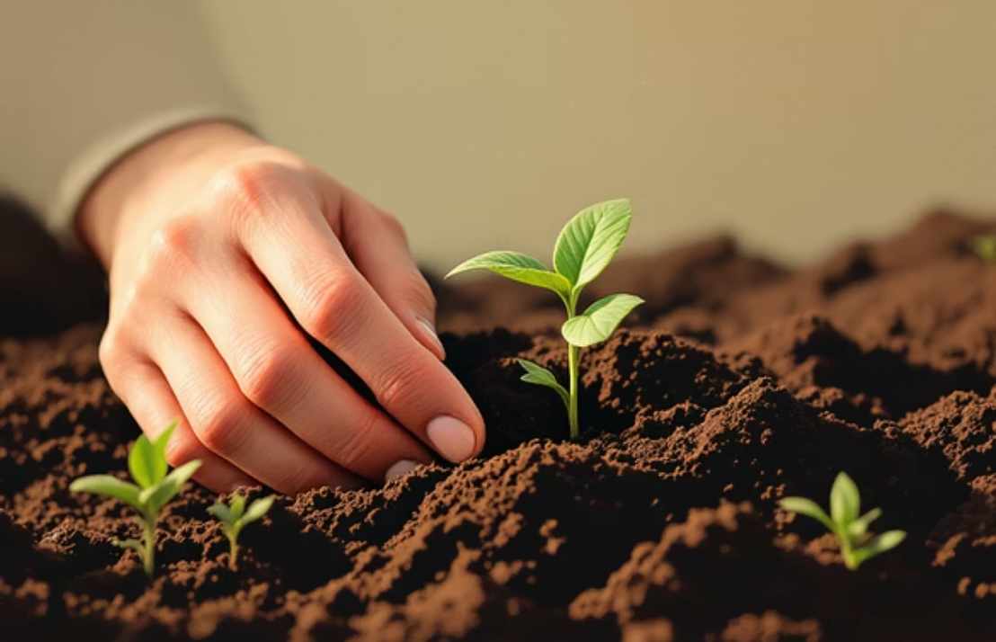
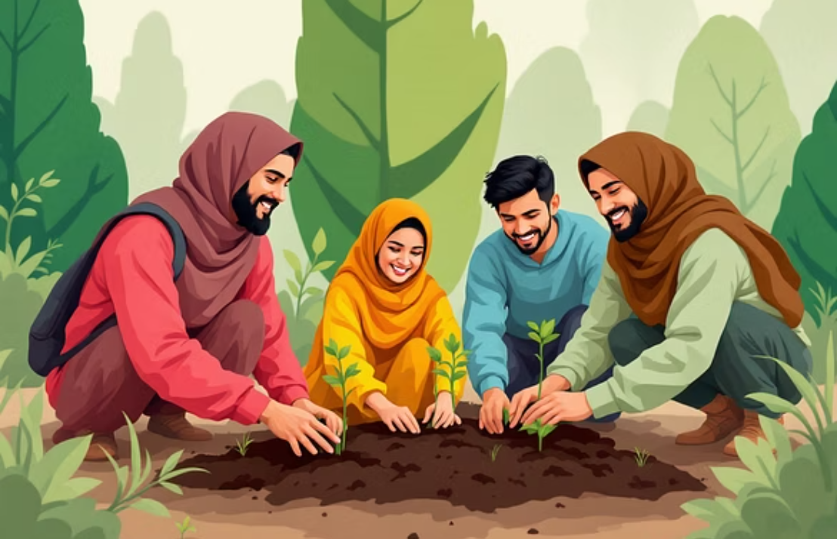

The Vision: Cultivating a New Mindset
This project is a blueprint for national renewal, focusing on coexistence, innovation, and ecological pride.
It is not just about restoring forests; it is about cultivating a new mindset for generations to come.

Slide 10






A Blueprint for National Renewal
1
Sustainable Future
2
Innovation & Technology
3
Community & Education
4
The Power of Seeds
By merging the power of seeds, the efficiency of modern agriculture, and the unity of community, Pakistan can transition toward a greener, cleaner, and more sustainable future.

